Slide 1
Town Buildings/DPW Administration FY26 Budget
Town Administrator Justin Sultzbach

Slide 2
FY26 Budget Drivers
Within this fiscal year, both 105 S. Main Street (Town Hall/COA/Community Center) and 99 S. Main Street (Public Safety Building) will open (early CY 2026)
This project is a nearly $75 million investment in the future of Middleton.
As we have seen with the ongoing capital issues experienced at Masco, new buildings do not stay new - and failing to be proactive in the maintenance of new facilities can create hundreds of thousands of additional costs related to deferred maintenance

Slide 3
FY26 Supplemental Budget Request(s)
Funds a full-time Facilities Director (1.0) FTE
This position would serve Town Hall, the Council on Aging, Police, Fire as well as the Flint Public Library.
Salary for FY 26 at $110,000

Slide 4
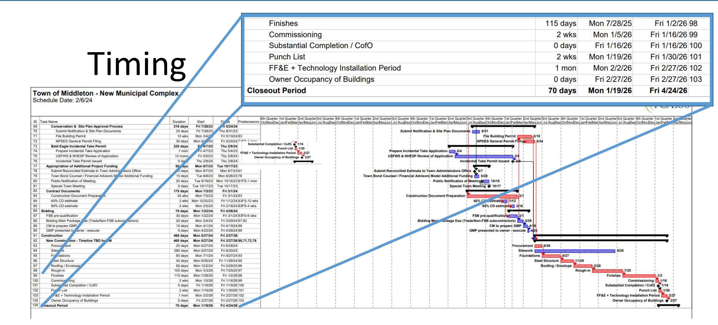
Timing of Municipal Campus Project

Slide 5
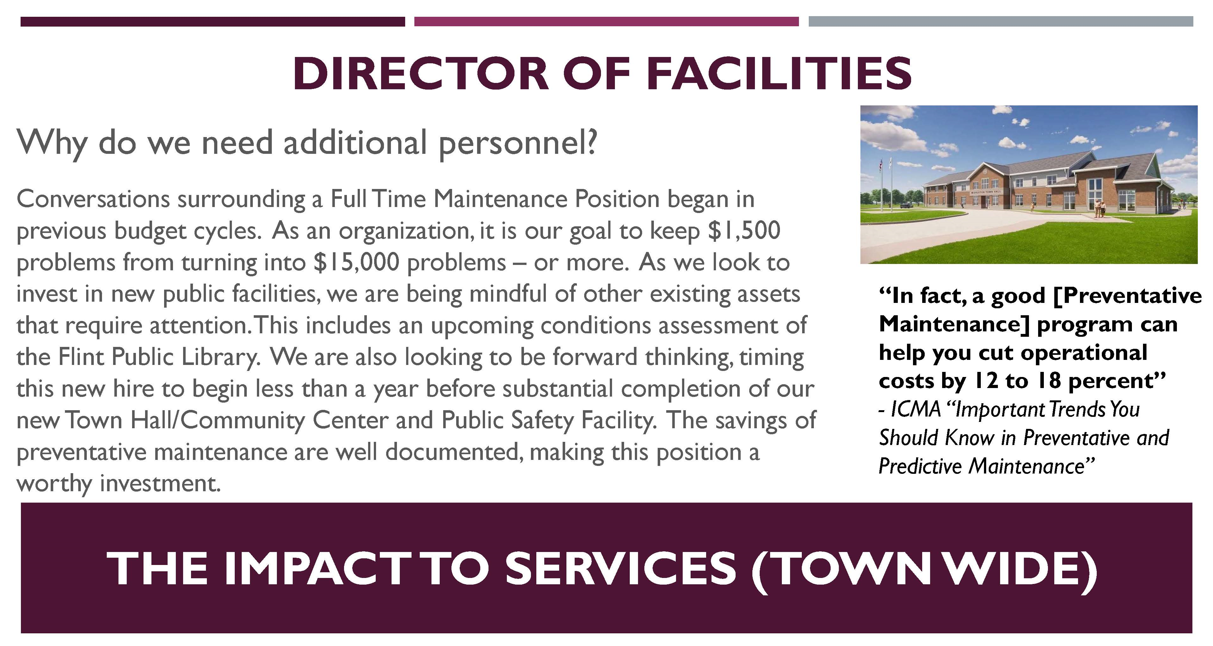
Justification of Request

