Slide 1
Fire Department FY26 Capital Budget
Douglas K. LeColst

Slide 2

Capital Requests
Apparatus Mobile Radio Replacement
Ladder-1 Replacement
Purchase of new Utility Vehicle (UTV)
Purchase of Forestry Equipment
Funding for Assistance to Fire Fighter Grant (AFG)
Funding for MassTrail Grant

Slide 3
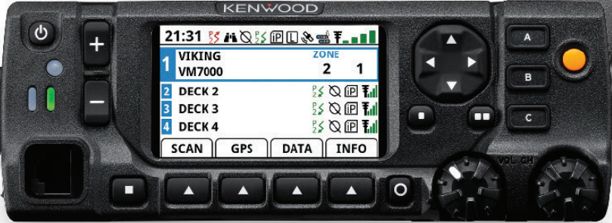
Apparatus Mobile Radio Replacement
Asking for $24,500
Current radios were purchased in 2008
No longer supported by the manufacturer
Year 2 of a 4-year replacement project
Portable radios are OK; FEMA AFG 2019.
Notes:
Portable radios – These are ok based upon age (2020 after purchase) however, depending on total personnel we are still experiencing shortages.

Slide 4
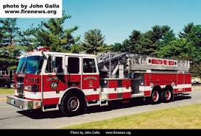
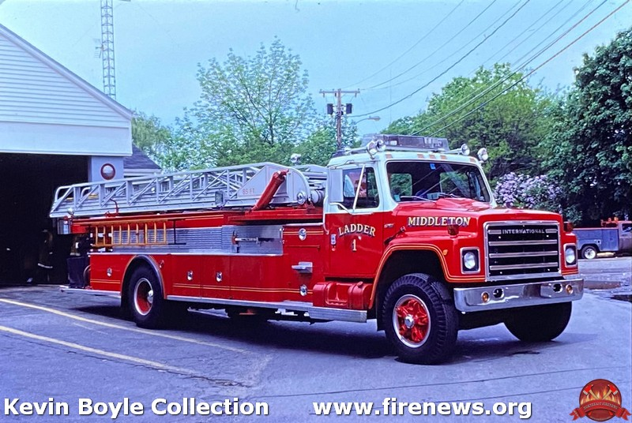
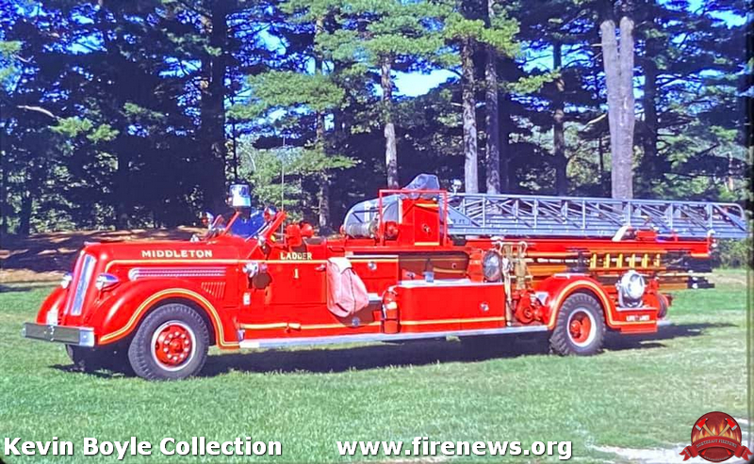
Replacement of Ladder-1 (1999 Sutphen)
Asking for $2.2 million
Rapidly approaching 30 years of age
NFPA Guidelines:
>15 years – Place in reserve status
>25 years – Retire vehicle
Change in focus with refurb/paint options
Limited availability in parts
AFG application submitted for $2.1 million
Estimated lead time once ordered is roughly 3 years

Slide 5
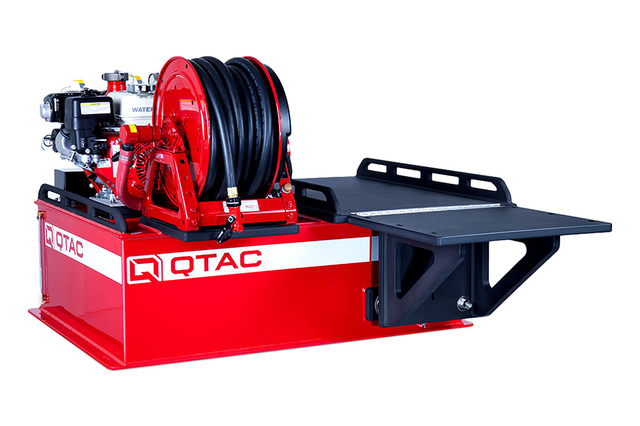
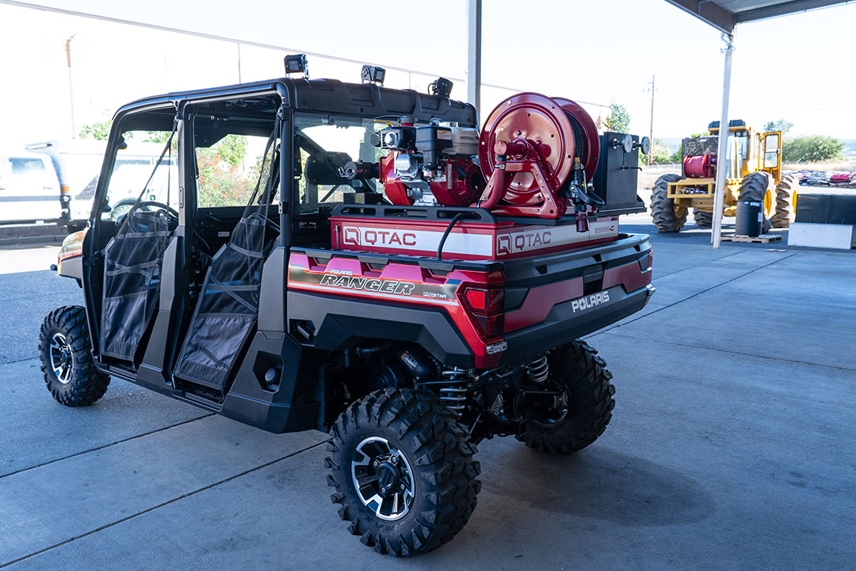
Purchase New Utility Vehicle (UTV)
Asking for $58,545
Purchase new UTV for the following incidents/locations:
Wildland Fires – sorely needed
Rail Trail Access/Boxford State Forest
Chief Wills Day
Vehicle would have EMS and Fire capabilities
Applied for a Mass Trail grant to cover up to 80% purchase

Slide 6
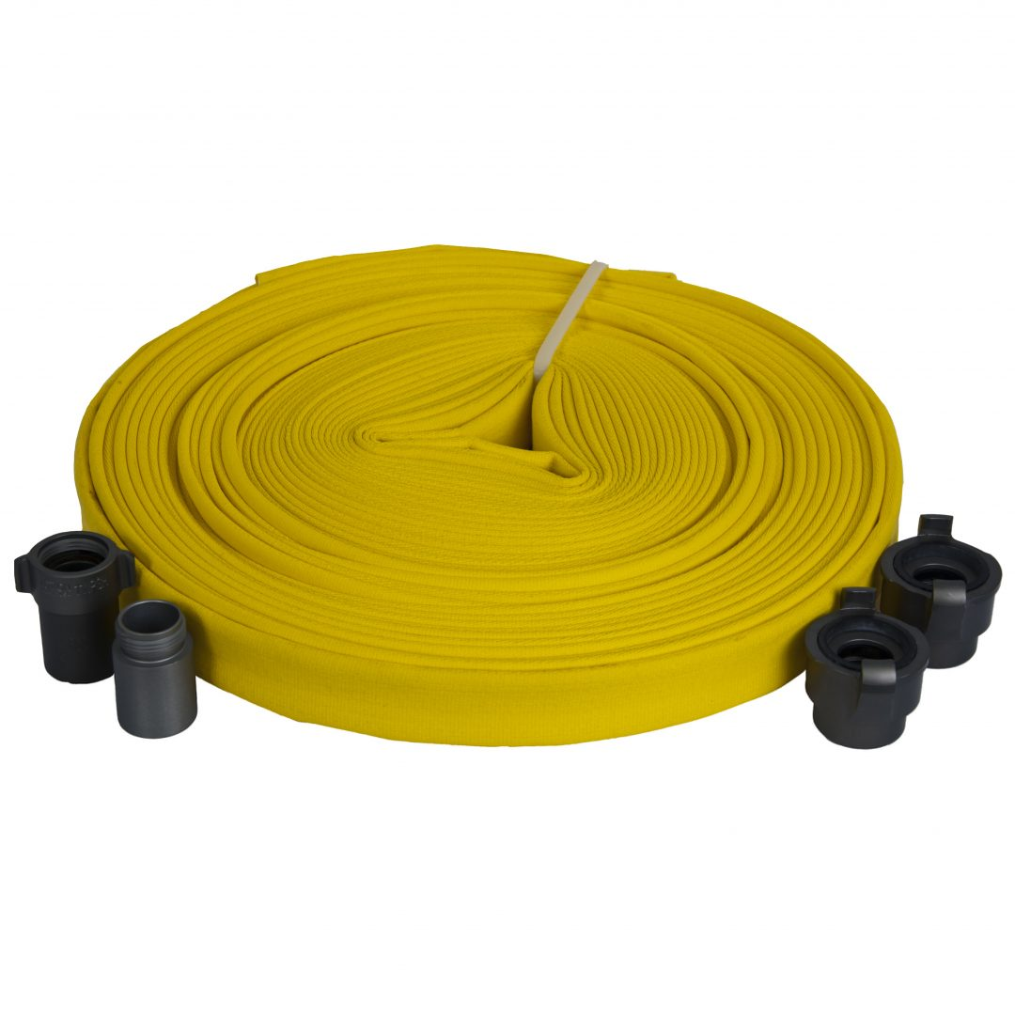
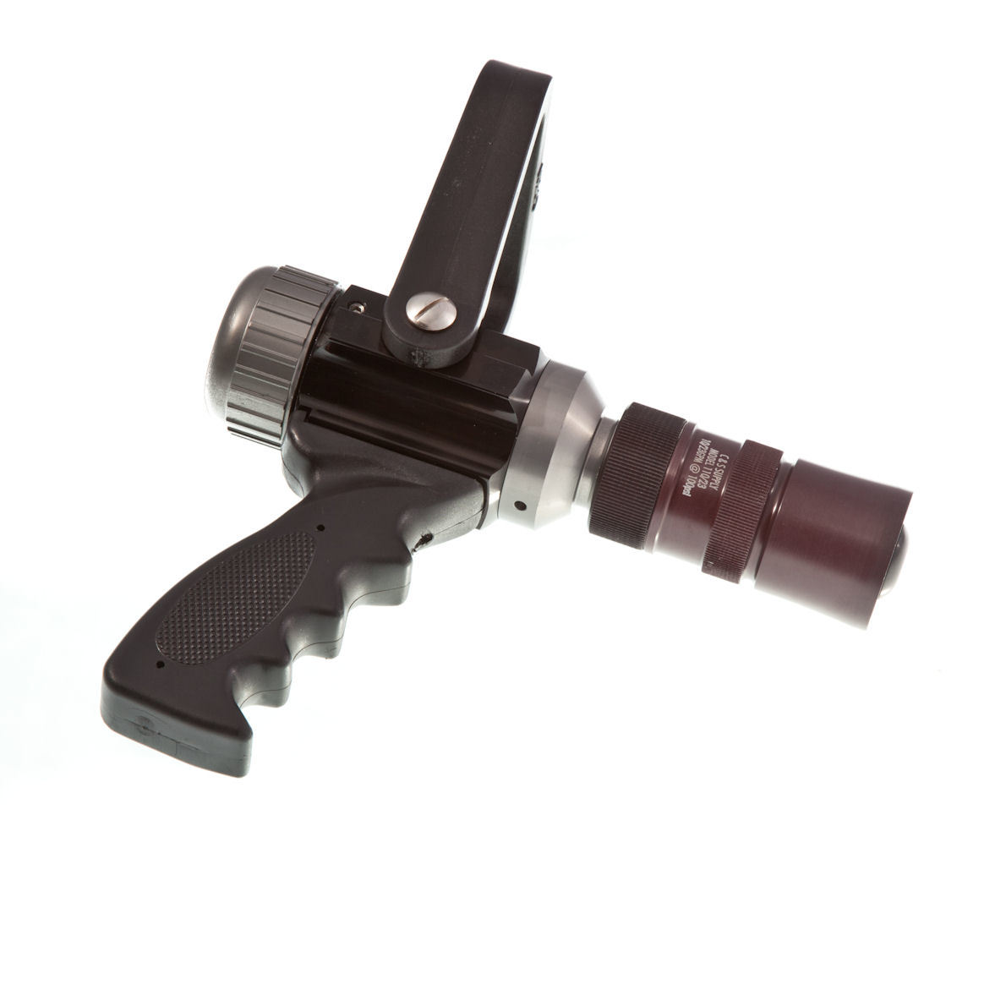
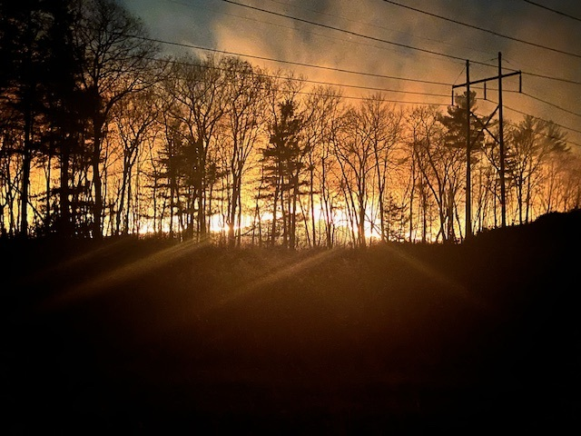
Purchase of Forestry Firefighting Equipment
Asking for $6,000
Replace older equipment that is >10 years old
Forestry Hose
Nozzles
Fittings
A recent AFG was submitted for the replacement of this equipment. These funds would be needed only if unsuccessful with the grant

Slide 7

FY2024 Assistance To Firefighter Grant
Two separate grants recently submitted through the AFG
$2.1 million towards the replacement of Ladder-1
$109,356 towards the replacement of Wildland firefighting equipment and personal protective equipment
Town share for both grants would be $105,278.86
Grant awards announcements expected to begin on or around April 30, 2025

Slide 8
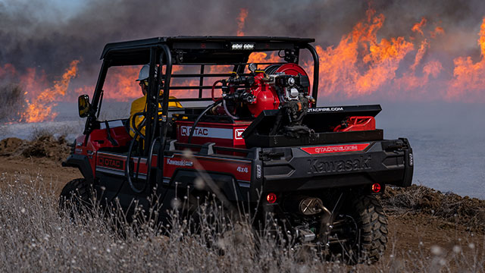
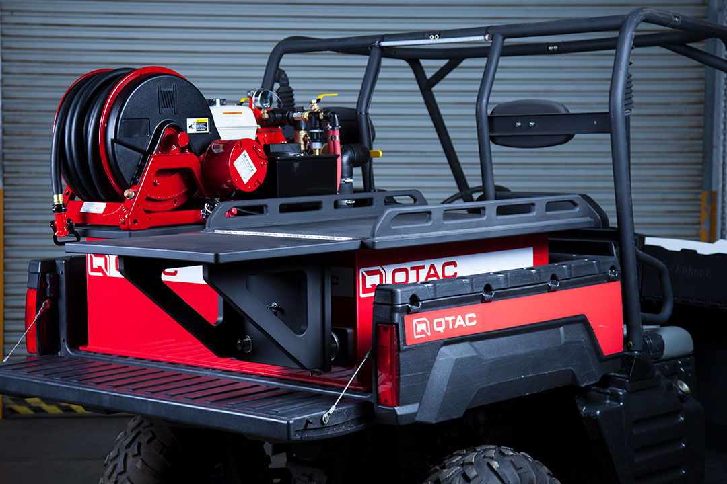

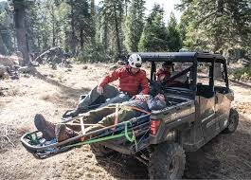
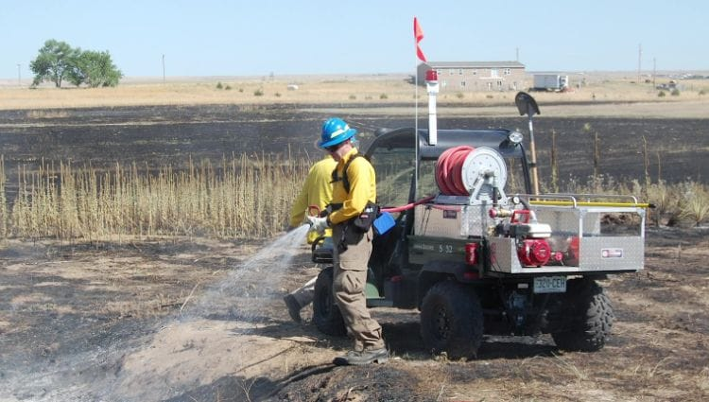
MassTrail Grant Program Match
The department recently applied for funding through the MassTrail Grant
If awarded, this would cover up to 80% of the costs associated with a new Utility Terrain Vehicle (UTV)
Total cost of the UTV is $61,500. If successful, the town’s share would be $12,294

